Slide 1
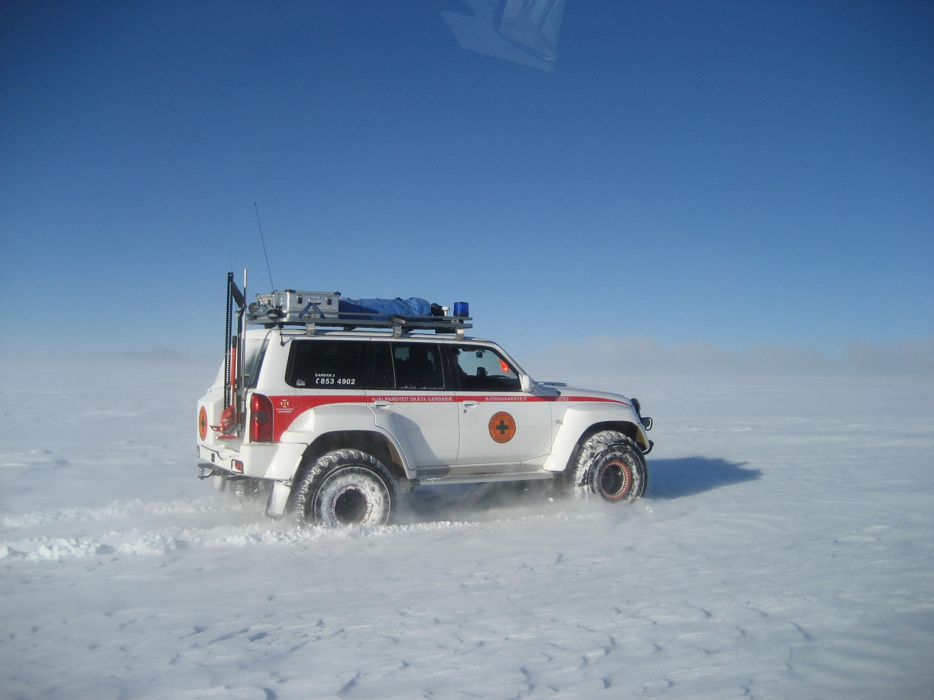
野外急救工作坊
Notes:
Photo: ICESAR; Glacier Jeep
This presentation is for use in WFR as a course introduction.
It is optional but recommended.
This is an opportunity to discuss wilderness context and the spectrum of pre-hospital care.
It is an opportunity to discuss the various roles a WFR may play.

Slide 2
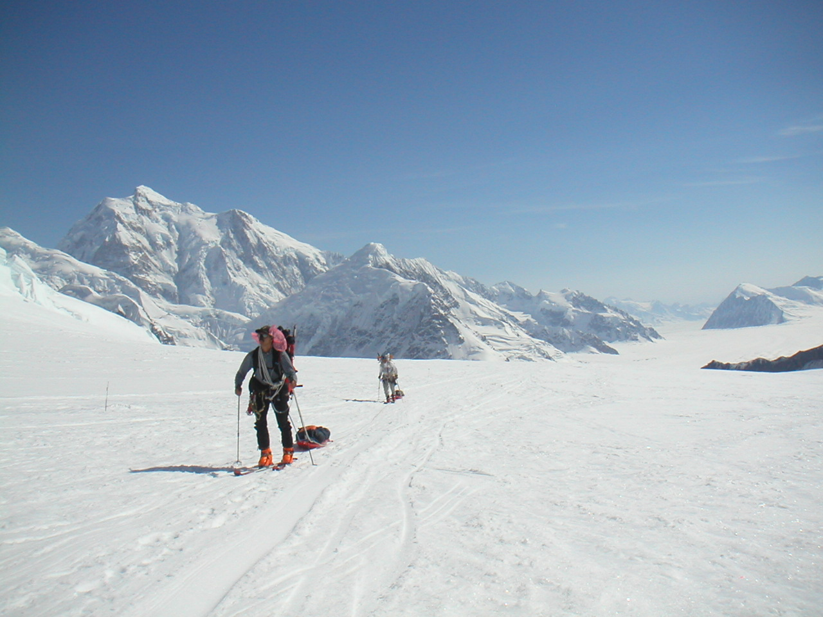
甚麼是野外環境？
Notes:
Photo: Brad Sablosky; Skywagon BS185, Northern Quebec
Expedition medicine:
Usually an intact group that starts out healthy.
The medical officer usually knows the patient.
Most medical problems can be anticipated.
The medical officer’s role is defined in advance.
Most environmental challenges can be anticipated.
Medical kit can be customized to trip.
Evacuation options can be scouted in advance.
Photo: Greg Friese; Boundary Waters, MN

Slide 3
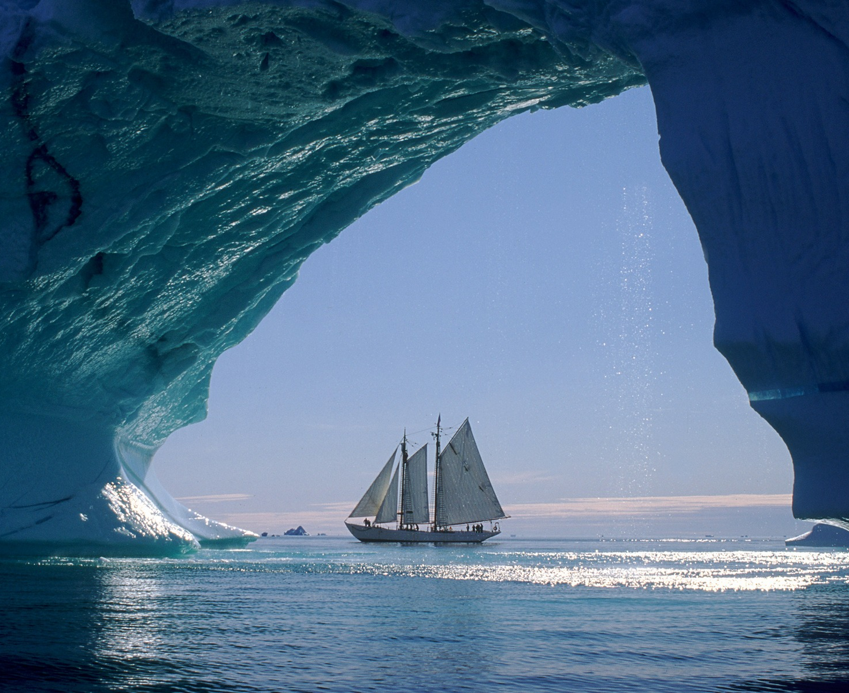
野外環境
難以及時取得完善的醫療照顧
惡劣的環境
有限的設備資源
在野外我們需要想到更多，還需要做到更多！
Notes:
Photo: Elliot Rappaport; Arctic Schooner Bowdoin
Wilderness context: Any environment where access to definitive care is delayed by logistics, distance, or hazard, and where the risk to the patient and/or rescuers is increased as a result.
Could be a remote wilderness location or an urban disaster.
Photo: Tom Clausing

Slide 4
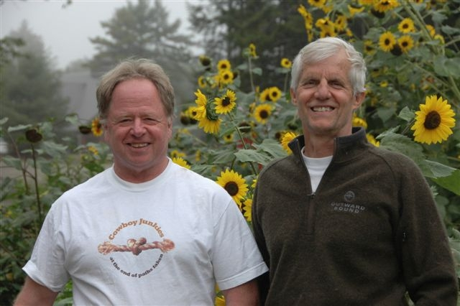
國際野外醫學協會 WMAI
Dr. Peter Goth
Dr. David Johnson
Notes:
Peter Goth is the founder and first president of WMA.
David Johnson is the current owner, president, and medical director.
The flowers could not be avoided.

Slide 5
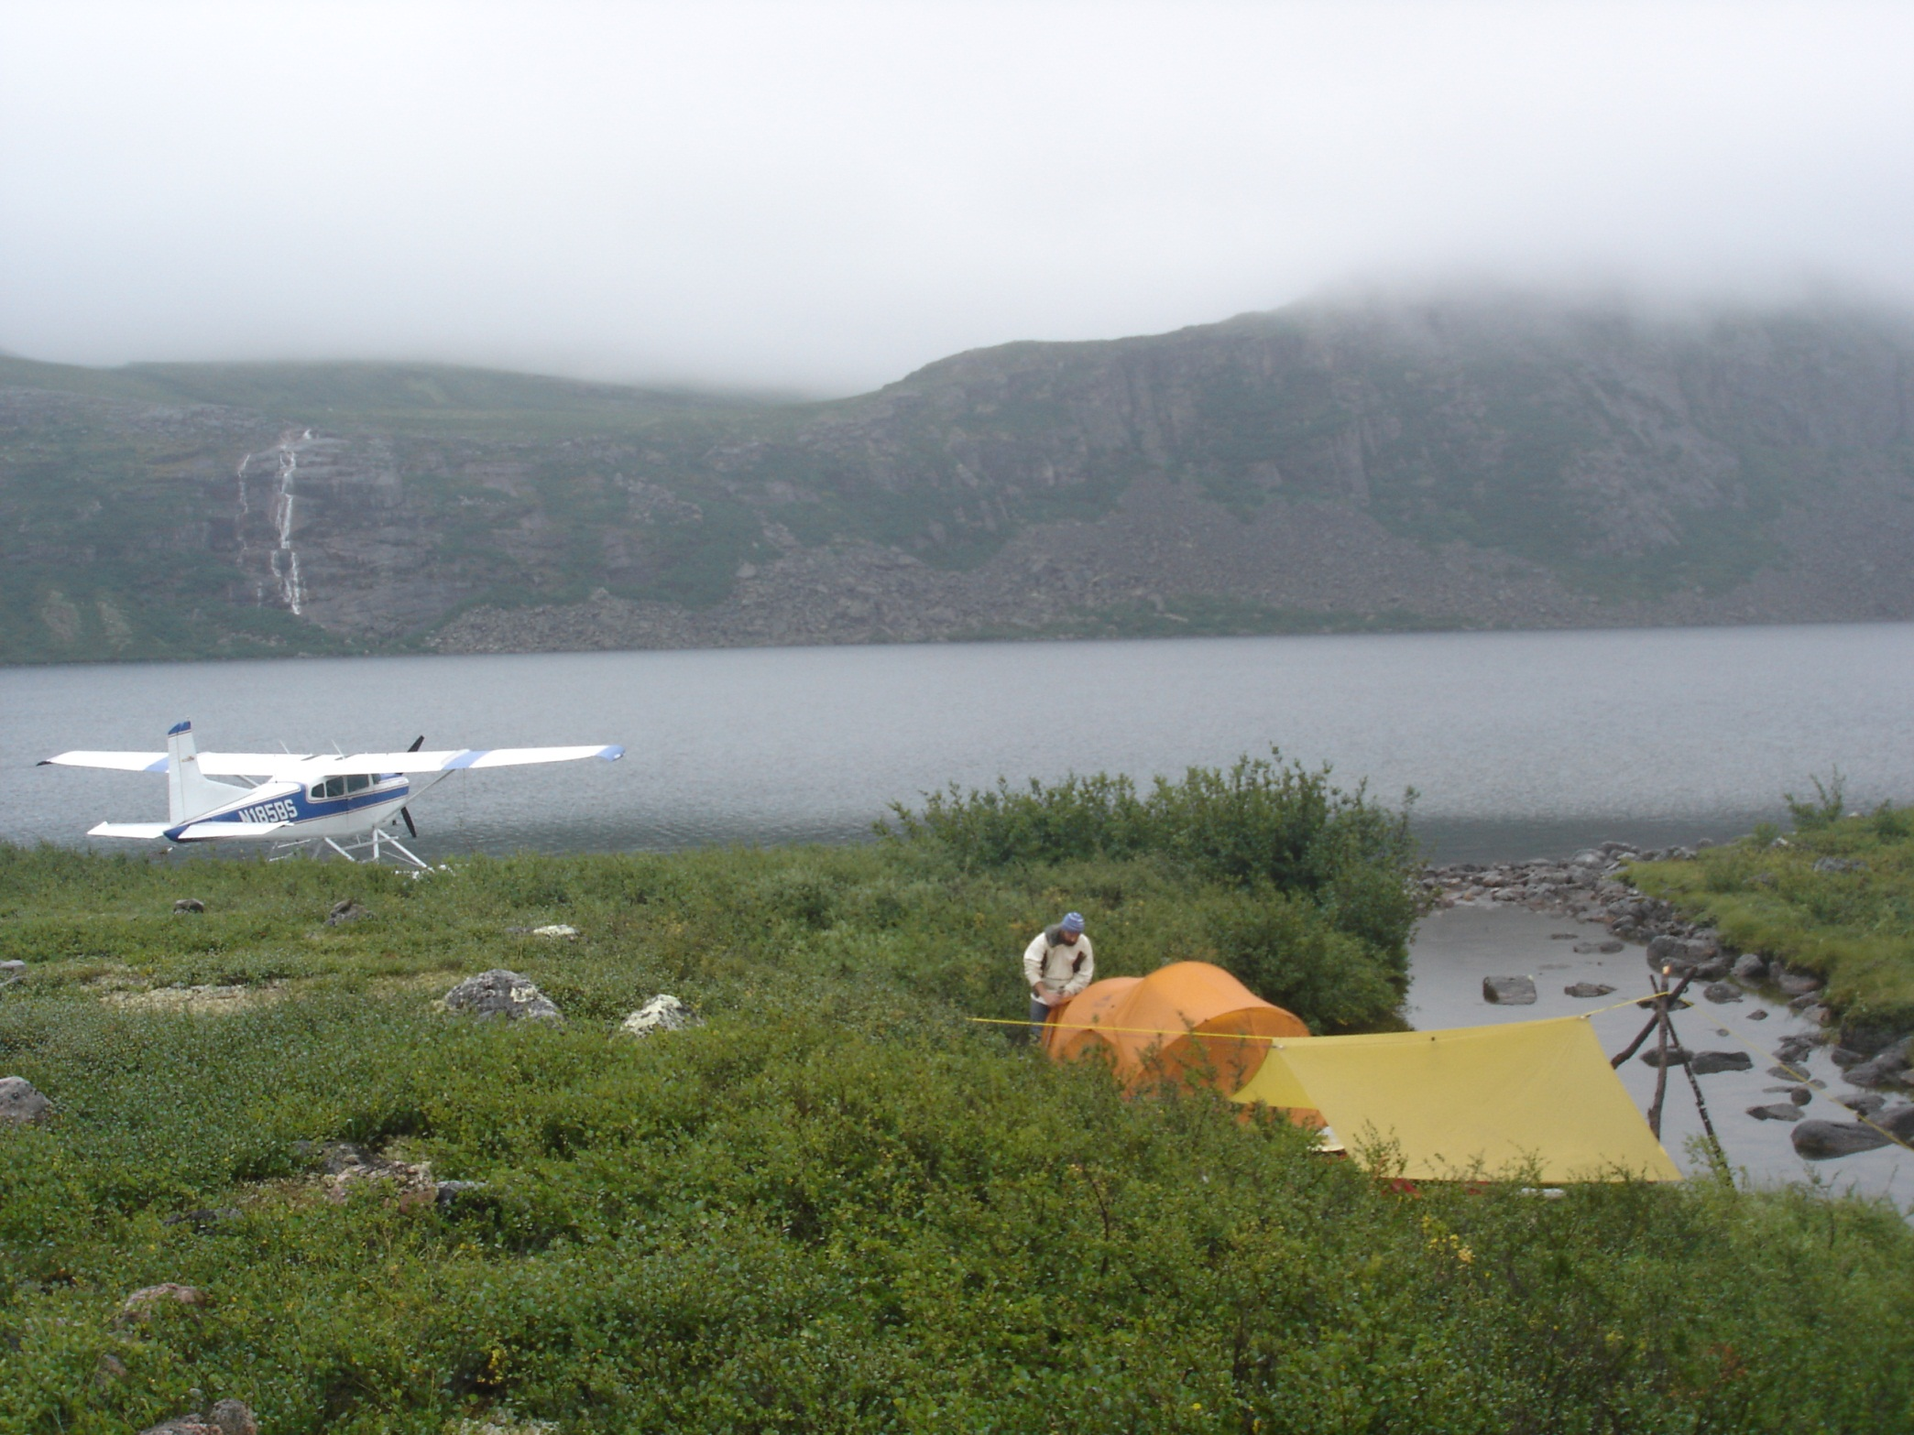
遠征探險
Notes:
Photo: Brad Sablosky; Skywagon BS185, Northern Quebec
Expedition medicine:
Usually an intact group that starts out healthy.
The medical officer usually knows the patient.
Most medical problems can be anticipated.
The medical officer’s role is defined in advance.
Most environmental challenges can be anticipated.
Medical kit can be customized to trip.
Evacuation options can be scouted in advance.
Photo: Greg Friese; Boundary Waters, MN

Slide 6
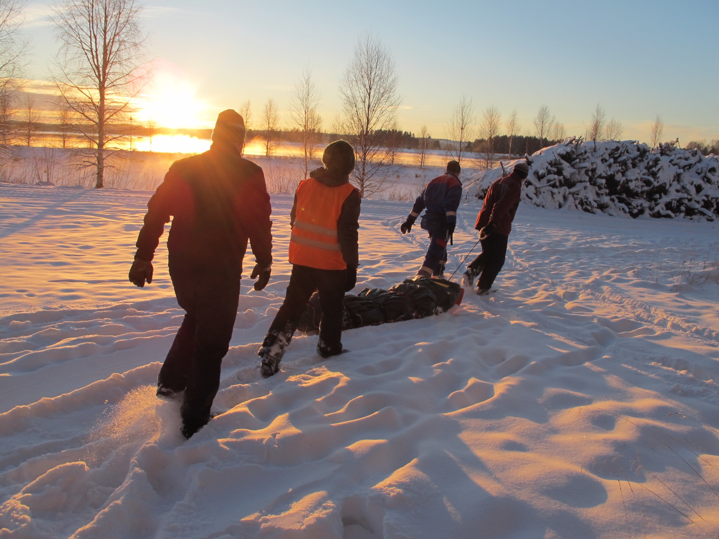
户外教育
Notes:
Photo: Brad Sablosky; Noon in Finland
Experiential education:
Risk mitigation may run contrary to program goals.
Your medical role is secondary to the role as guide or instructor.
Teaching wilderness first aid may be part of your job description.
Problems may be medical or behavioral and it can be difficult to tell the difference.

Slide 7
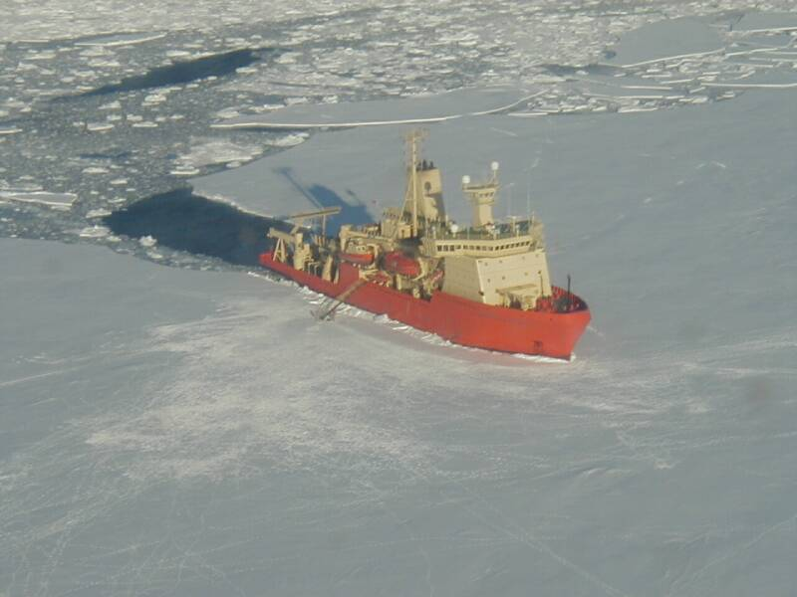
勘探與作業
Notes:
Photo: Nathanial B. Palmer; Antarctic Ice
Exploration and Industry:
Often a form of occupational medicine. OSHA rules can be impossible to enforce.
Care and evacuation tend to be protocol driven.
There can be a cost incentive not to evacuate.
Field medical kit may be designed by home office staff.
Easy to get in over your head, eg: WFR’s or EMT’s serving as ships medical officers.
Medical role may be discrete or combined with other duties.
Photo: Al Hickey; Antarctic ice shelf from the RV icebreaker Nathanial B. Palmer

Slide 8
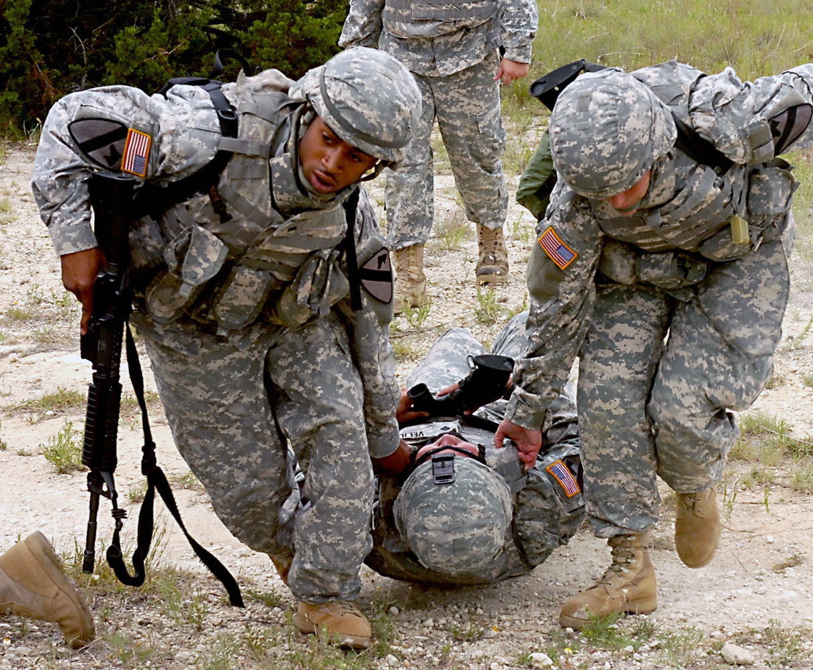
戰地急救
Notes:
Photo: US Army
Combat:
Not easy to follow protocol.
Civilian EMS standards of care are irrelevant in many situations.
Medical role combined with combat duties. Shoot first, treat later.
More emphasis on penetrating trauma.
Medical role also includes routine care of illness, but this can be taking place under dangerous circumstances.
Providers often function in much more advanced capacity than civilian counterparts. USAF extended duty EMT’s (EDEMT) for example.

Slide 9
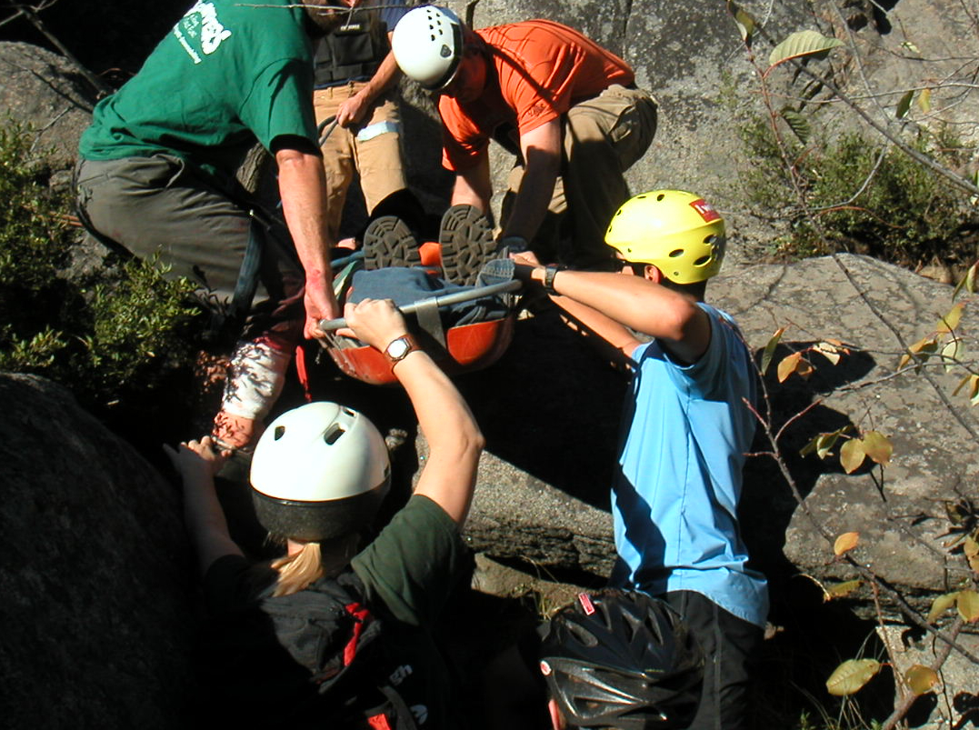
搜救隊
Notes:
Photo: Tom Clausing
Search and Rescue:
Medical role usually well defined in a chain of command.
Missions range from known medical in a known location to unknown medical in an unknown location.
Technical expertise is often as important as medical.
Often works closely with EMS but street EMS standards of care may be impossible to meet in many situations.
Occasional conflicts between wilderness SAR practice and street EMS protocols. Good place to use understanding of differences in plan in different parts of the pre-hospital spectrum.

Slide 10
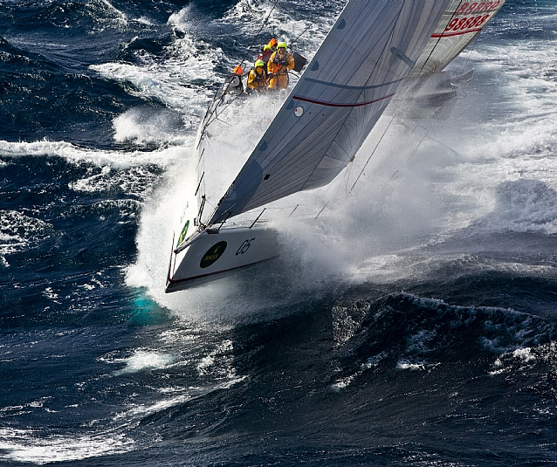
遠洋
Notes:
Photo: Alan Briety
Voyaging:
Offshore is most remote wilderness on earth.
But, boats can carry more medical supplies and equipment than a backpacker.
Evac times can be days to weeks.
Medical officers have more latitude in scope of practice allowed by law.
A small boat at sea can be a perpetually unstable environment.
Evacuations at sea are especially high-risk.

Slide 11
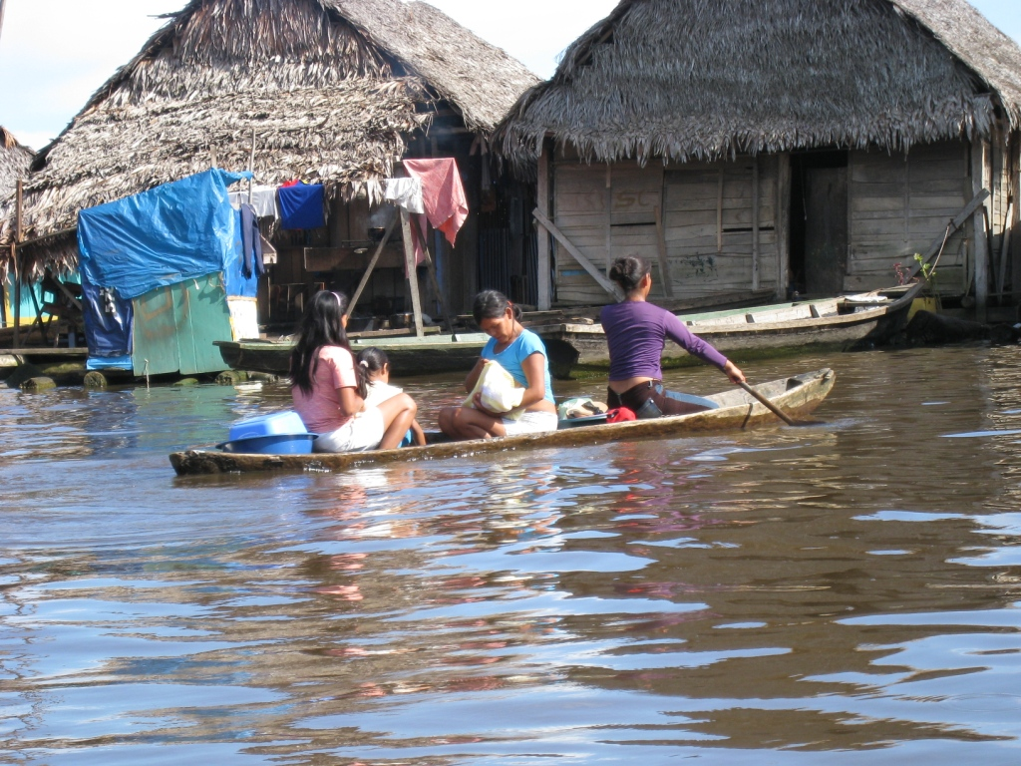
貧困地區

Slide 12
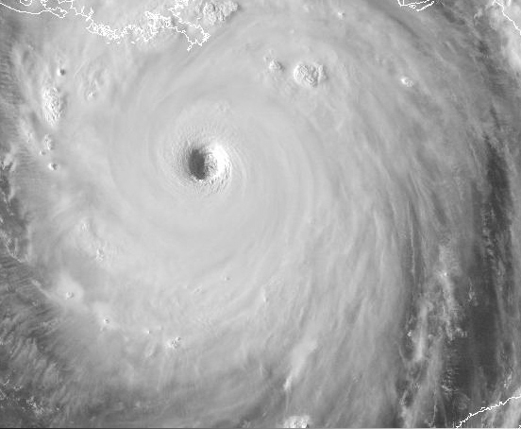
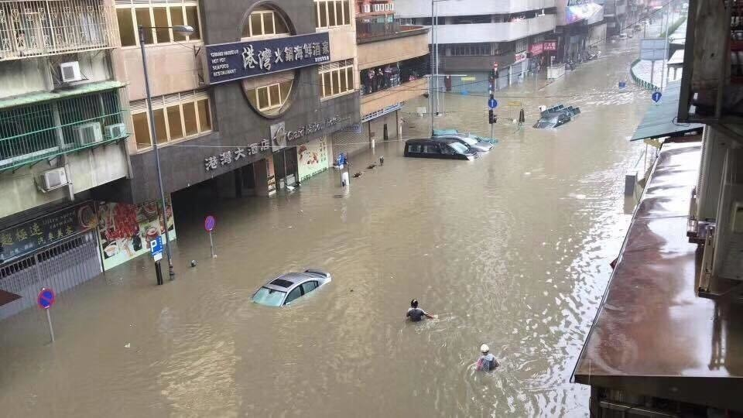
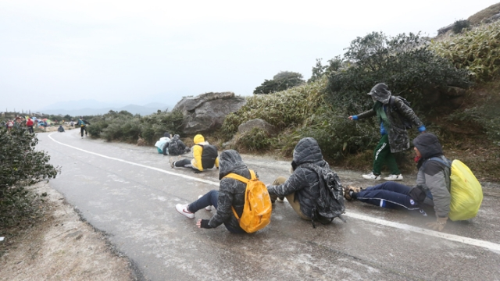
災難
Notes:
Photo: NOAA
Disaster:
Difficult to anticipate medical problems.
Infrastructure may be destroyed.
Demands ability to function with medical support, and without it.
Rescue personnel may have enough problems just looking after themselves.
Large Photo: NOAA; Hurricane Katrina

Slide 13
遇到此情況，你要如何開始施救呢？
Notes:
Peter Goth is the founder and first president of WMA.
David Johnson is the current owner, president, and medical director.
The flowers could not be avoided.

Slide 14
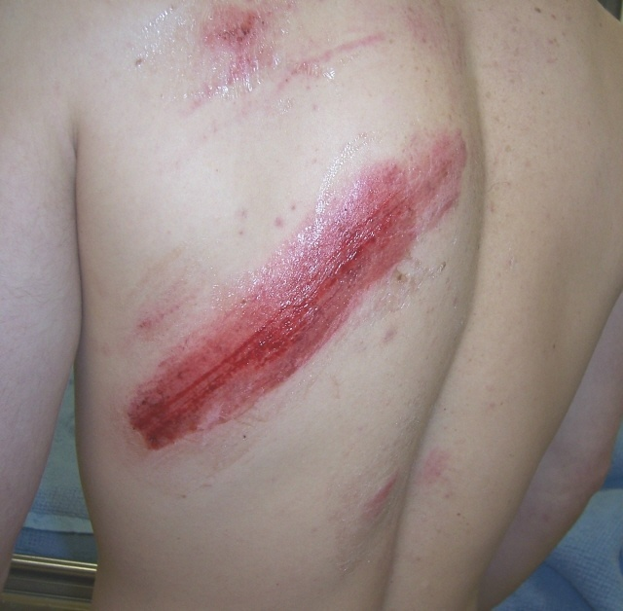
你發現傷者背部是這麼的…
Notes:
Photo: Jeff Isaac; skier vs tree. Fortunately for him he was wearing body armor.
This is a large abrasion overlying a hematoma.
Because of the amount of pain, it took a while to determine that there was no critical system injury, and no unstable musculoskeletal injury.
Now the major concern is wound cleaning and the A’ of infection and pain.

Slide 15
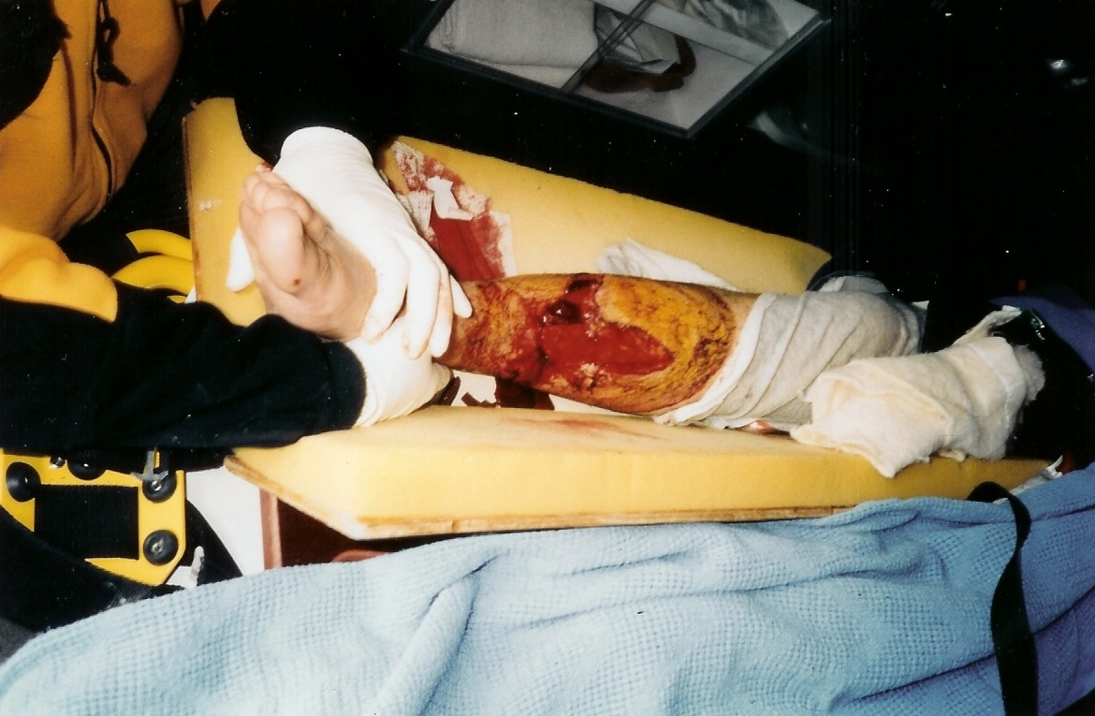
你發現傷者腿部是這麼的…
Notes:
Photo: Crested Butte EMS.
Snow machine accident. This patient set the world record for a snow machine jump. Unfortunately, landing under his machine disqualified him.
Angulated, open fracture of the distal tibia and fibula. This deformity was reduced with TIP.
The tibia is covered with blood and protruding through the wound. Complete reduction required pulling the skin out from under the bone end with a gloved finger.
The field splint has been loosened for wound care and examination. Note the hands-on stable. Note the gloves. The practitioner was also wearing eye protection.

Slide 16
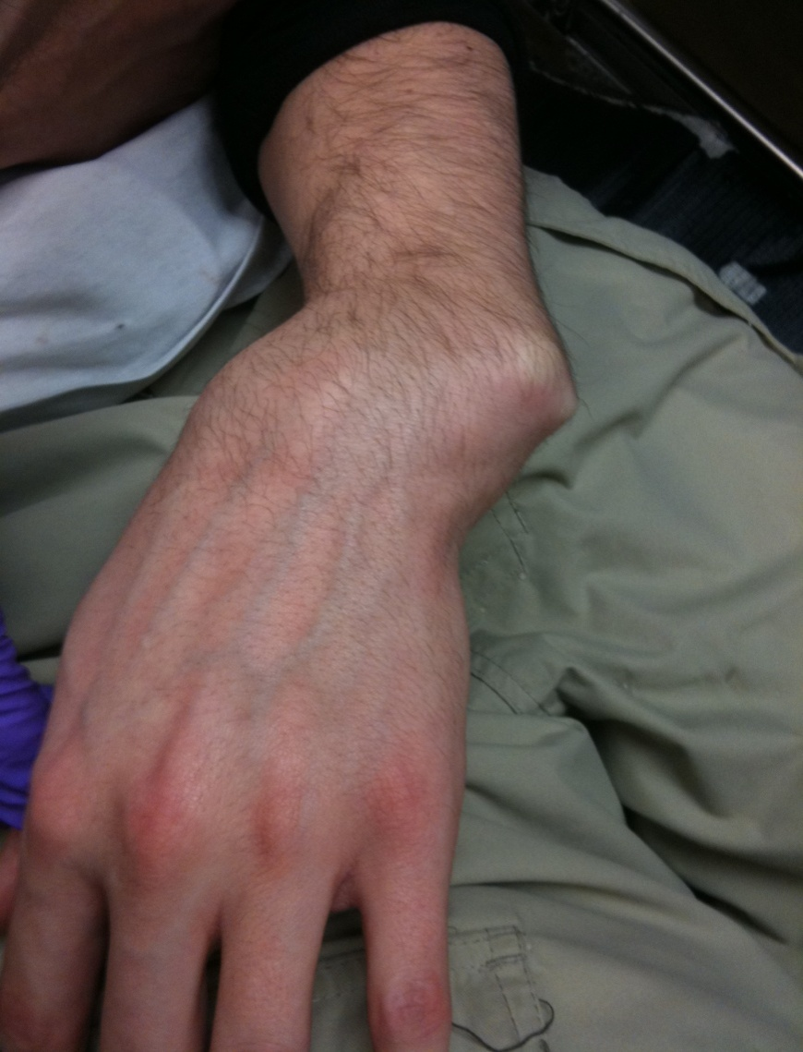
手是這樣，你現在該做甚麼？
Notes:
Photo: Jeff Isaac
Fracture/dislocation of the wrist. Snowboard accident.
This deformity quickly resulted in distal numbness.
Unlike the grossly deformed ankle fx/dislocation in case 14, this was very difficulty to realign and required surgical stabilization.
In the field this would be a limb threatening emergency. Sometime TIP is not possible but you don’t know until you try.
See also the skin tenting and ischemia over the ulnar styloid. Over time, this degree of skin ischemia will result in skin breakdown.

Slide 17
傷患評估系統
Notes:
Photo: Justina Leskow. Aboard the SSV Robert C. Seamans, mid-Pacific.

Slide 18
傷患評估系統
1
現場評估
首要評估
次要評估
Notes:
Three parts intended to be accomplished in order.
An organized and rehearsed format for gathering information will vastly improve efficiency, especially when stress is high.

Slide 19
現場評估
2
穩定現場
個人安全
同伴安全
公眾安全
傷患安全
創傷
内科
環境
安全 傷病機制
數目
現場評估
*
傷患人数
施救者人數
資源
“現場評估能保証你安全!”
Notes:
Three parts of each part of the PAS.
Note sub heading: Stabilize the scene. Be sure you’re safe, be sure your team is safe, and be sure the patient is safe from further harm. Figure out what is going on and how many people are involved.

Slide 20
首要評估
4
穩定傷病者
脈搏
出血
呼吸道
呼吸
循環系統 呼吸系統
神經系統
首要評估
*
意識水平 AVPU
脊柱
“首要評估讓你快速檢查傷患的三個重要身體系統。”
Notes:
Note the sub heading: stabilize the patient
Three parts of the initial assessment
\

Slide 21
次要評估
5
完成後即可處治
身体檢查 SAMPLE 病歷
生命體征
次要評估
*
“完成所有清單上的内容, 然後根據問題緊要性逐個處理問題.”
Notes:
Self Explanatory

Slide 22
野外醫学的普遍原理
Notes:
Leonardo DaVinci: Vitruvian man.
General Principles are divided into two presentations; this one and General Principles of Wilderness and Rescue Medicine. They go together, but either may be presented first, depending on instructor preference.
* indicates required content.
The general principles guide the program.
This is the beginning of, and basis for, the kind of critical thinking that we are asking of our students.

Slide 23
嚴重或不嚴重?
穩定或不穩定?
緊急或不緊急?
好轉或惡化?
*
緊急撤離 不撤離
Notes:
This is the question on everyone’s mind. How do I tell the difference?
It is a primary goal of this course is to provide the information and develop the skills necessary to make this distinction.
This is the most generic and important diagnosis in medicine and rescue.
Note and mention that the terms “diagnosis”, “assessment”, and “problem” are often used interchangeably.
Assessment moves from generic to specific as time and medical care progresses. We may never be able to make a specific diagnosis in the field, but we should be able to decide if it is serious or not serious.
DJ uses the terms precision and clarity to describe this principle. We don’t need to be precise, but we do need to be clear.

Slide 24
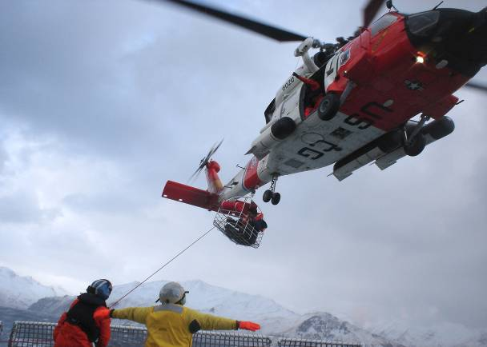
風險/受益比
避免用高風險方法解決低風險問題!
*
“利大於弊的決策，來自清晰的病患評估.”
Notes:
Photo: US Coast Guard
Every diagnostic distinction we make in this curriculum has practical field application. Here is the first example: Risk vs Benefit judgment is the practical application of the serious vs not serious field assessment.
There is a tendency to run high-risk rescues for low risk problems because people on scene can’t tell the difference between an emergency and something that’s not.
The well trained WFR or WEMT on scene can balance risk and benefit by setting an appropriate level of urgency or restraint. Most backcountry medical problems are not life-threatening and do not warrant a high risk evacuation.
It is a primary goal of this course to develop the critical thinking necessary to make this judgment.
FYI – the heli in the photograph crashed during a rescue off the Alaskan coast and killed the seven sailors it had just rescued from a foundering ship.
The helicopter is the high risk icon used in our presentations, but it is not the only form of high risk rescue. Consider night evacs in rough terrain, crossing open water in rough weather, transferring a patient from a yacht to a large ship, and lowering a patient over a cliff face are other examples.

Slide 25
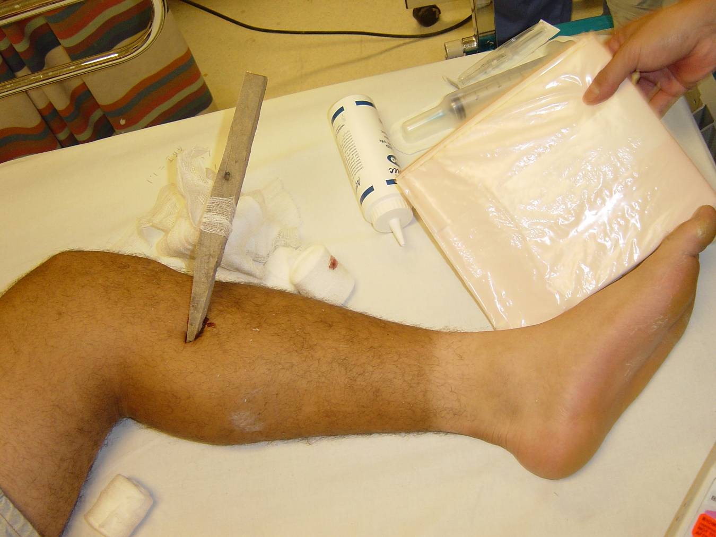
需要拔出來嗎？
Notes:
Photo: Jamie Butler.
Probably easy to remove. Definitely would inhibit extrication to medical care. Leaving it in for a long evac also guarantees an infection. This would be a difficult wound to irrigate. Clean the surface, but don’t force fluid into the puncture with a syringe. This will just drive bacteria further into the tissues. You can see that the splinter would carry bacteria through all the soft tissue layers. The chance of infection is high. Treatment for infection should begin immediately, including hot soaks and antibiotics, if available.

Slide 26
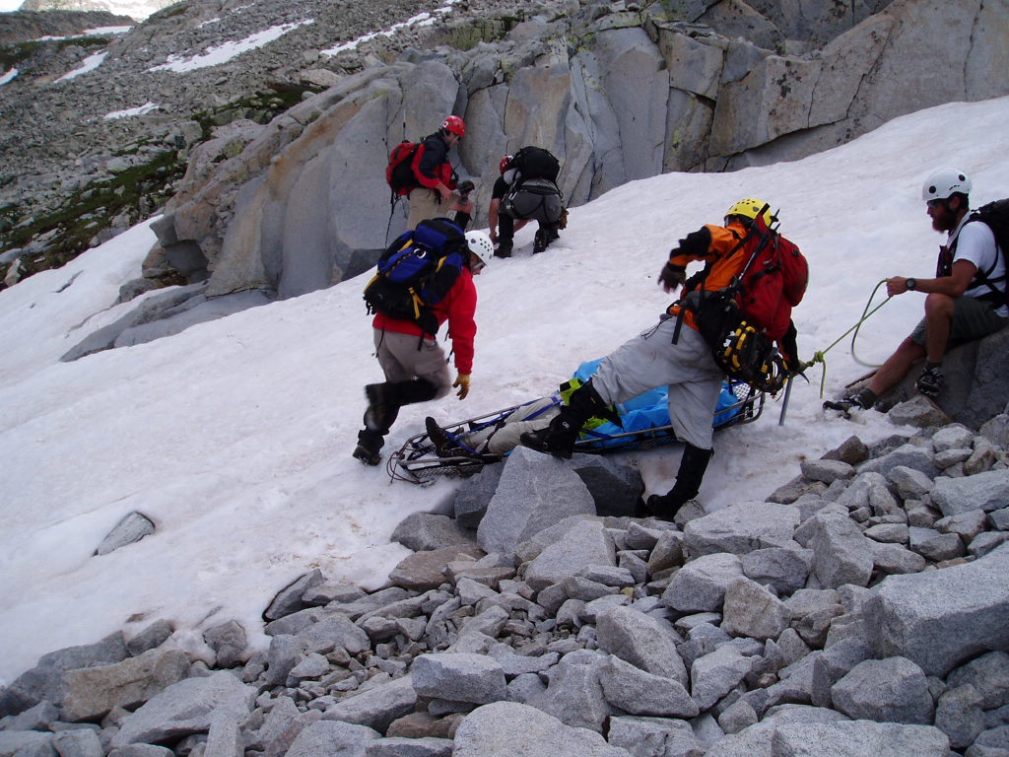
可能性和後果
Probability x Consequence
*
“…在偏遠環境裏受傷的可能性不會更高，但後果將會十分嚴重.”
Notes:
Photo: Jeff Isaac
People often consider risk to be a simple function of probability….”what are the chances?”
The photograph is from body recover in the Rocky Mountains. The probability of the hiker slipping and falling at the top of the snowfield was probably no greater than his probability of slipping and falling on an ice-covered sidewalk in town. The consequences were far more devastating, therefore the overall risk was much higher.
This same principle applies to minor medical problems like blisters that may be inconsequential in town, but devastating if allowed to become worse in the backcountry.
Risk reduction is a primary responsibility of the medical officer, and it includes addressing both probability and consequence.
What ever you do; Avoid high probability , high consequence events.

Slide 27
骨骼肌肉傷害
8
普遍評估:
穩定 – 能安全的使用
不穩定 – 必需穩定並且保護傷處；如出現缺血則需緊急撤離
野外環境
*
穩定 不穩定
Notes:
Generic to Specific; we are usually limited to a generic assessment in the field. A specific diagnosis can be made when and if x-ray and clinical evaluation is available.
This is an example of clarity vs precision. The injury may be clearly unstable, but we don’t know precisely why.
Remind students that it is possible to have a stable fracture, or an unstable sprain.
Unstable = unsafe to use, may cause further soft tissue or bony injury. Should be stabilized.
Stable = safe to use. Unlikely to cause further injury. May be stabilized for comfort.

Slide 28
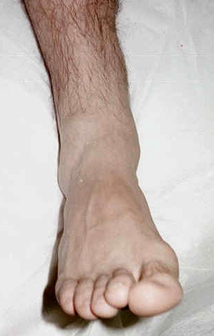
穩定嗎？
Notes:
Snowboard accident. Photo: Jeff Isaac
Severe ankle fx. Involves dital tibia and fibula. It may be a pylon fracture if the articular surface is involved.
This is an example of an unstable injury that requires no manipulation in the field. Distal CSM is good, the deformity is not severe.

Slide 29
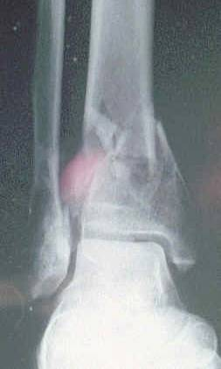
不穩定
Notes:
Snowboard accident. Photo: Jeff Isaac
Severe ankle fx. Involves dital tibia and fibula. It may be a pylon fracture if the articular surface is involved.
This is an example of an unstable injury that requires no manipulation in the field. Distal CSM is good, the deformity is not severe.

Slide 30
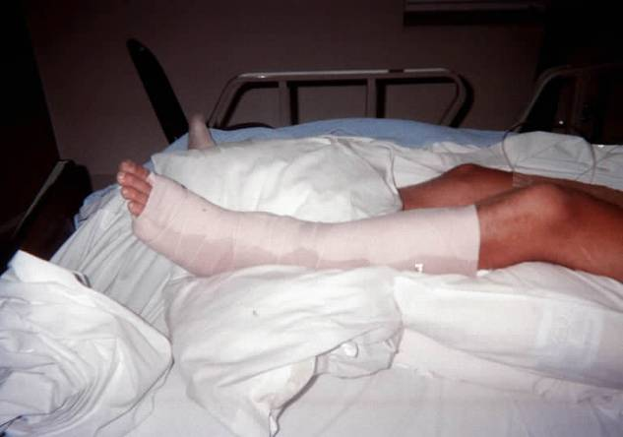
夾板穩定
13
完全:
提供穩定和保護
覆蓋長骨/關節的上下方
舒適:
没有受壓點或摩擦
可以調節
適宜:
剛好所需的長度
方便檢查血液循環
*
Notes:
Photo: Alan Bailey, Crested Butte EMS.
Complete splinting usually requires including the joint above and below a long bone injury, or the bone above and below a joint injury.
Compact splinting is aimed a keeping the patient somewhat functional if at all possible.

Slide 31
國際野外醫學協會 Wilderness Medical Associates International www.wildmed.cn
WMAI 微博
WMAI 微信
www.facebook.com/wildmedcn168
謝謝各位
Notes:
Wilderness context: Any environment where access to definitive care is delayed by logistics, distance, or hazard, and where the risk to the patient and/or rescuers is increased as a result.
Could be a remote wilderness location or an urban disaster.
Small photo: Elliot Rappaport; Schooner Bowdoin in the arctic.
Large photo: Jeff Isaac; -41F on the Slate River, Gunnison County Colorado.

